Slide 1
SPB1162LV
The Complexity of JPA
Jens Schauder (He/Him) Staff Engineer, VMware
SPB1162LV

Slide 2
The Complexity of JPA
2023-08-21
Jens Schauder (He/Him)
Spring Data Commiter

Slide 3
Disclaimer
•This presentation may contain product features or functionality that are currently under development. •This overview of new technology represents no commitment from VMware to deliver these features in any generally available product. •Features are subject to change, and must not be included in contracts, purchase orders, or sales agreements of any kind. •Technical feasibility and market demand will affect final delivery. •Pricing and packaging for any new features/functionality/technology discussed or presented, have not been determined.

Slide 4
I don’t give guarantees!
I was surprised at times as well.

Slide 5
Does EntityManager.persist save an entity to the database?
Yes.
No.
It depends.

Slide 6
Does EntityManager.persist save an entity to the database?
persist adds an entity to the persistence context. For this it needs an id.
This might enforce an insert statement.

Slide 7
Does EntityManager.find load an entity from the database?
Yes.
No.
It depends.

Slide 8
Does EntityManager.find load an entity from the database?
find returns an entity from the persistence context. Only if the entity doesn’t exist there it will be loaded from the database.

Slide 9
Does a query load entities from the database?
Yes.
No.
It’s complicated.

Slide 10
Does a query load entities from the database?
A query gets executed against the database. But if a returned entity is already in the persistence context, that instance will be returned. New data from the database will be ignored.

Slide 11
A has a list of B and a version attribute. If you change, remove or add a B, does the version of A change?
Yes.
No.
It’s complicated.

Slide 12
Updates to the collection trigger a version update. Updates to the element of the collections don’t.

Slide 13
Can you use Java Records for entities?
Yes.
No.
It depends.

Slide 14
Can you use Java Records for entities?
No, JPA is based on dirty tracking.
Since records cannot be mutated they cannot be used for entities.

Slide 15

But Why?

Slide 16
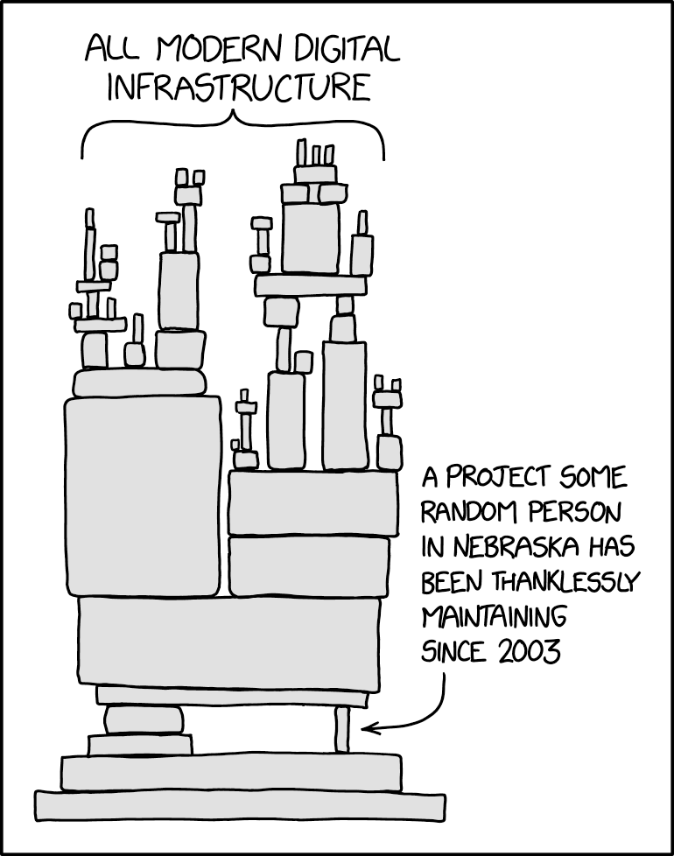
The Foundation
https://xkcd.com/2347

Slide 17
The Root Problem
All of JPA
Dirty Tracking

Slide 18

Dirty Tracking
https://unsplash.com/photos/qkTf-r5iZpE

Slide 19

Single Instance

Slide 20
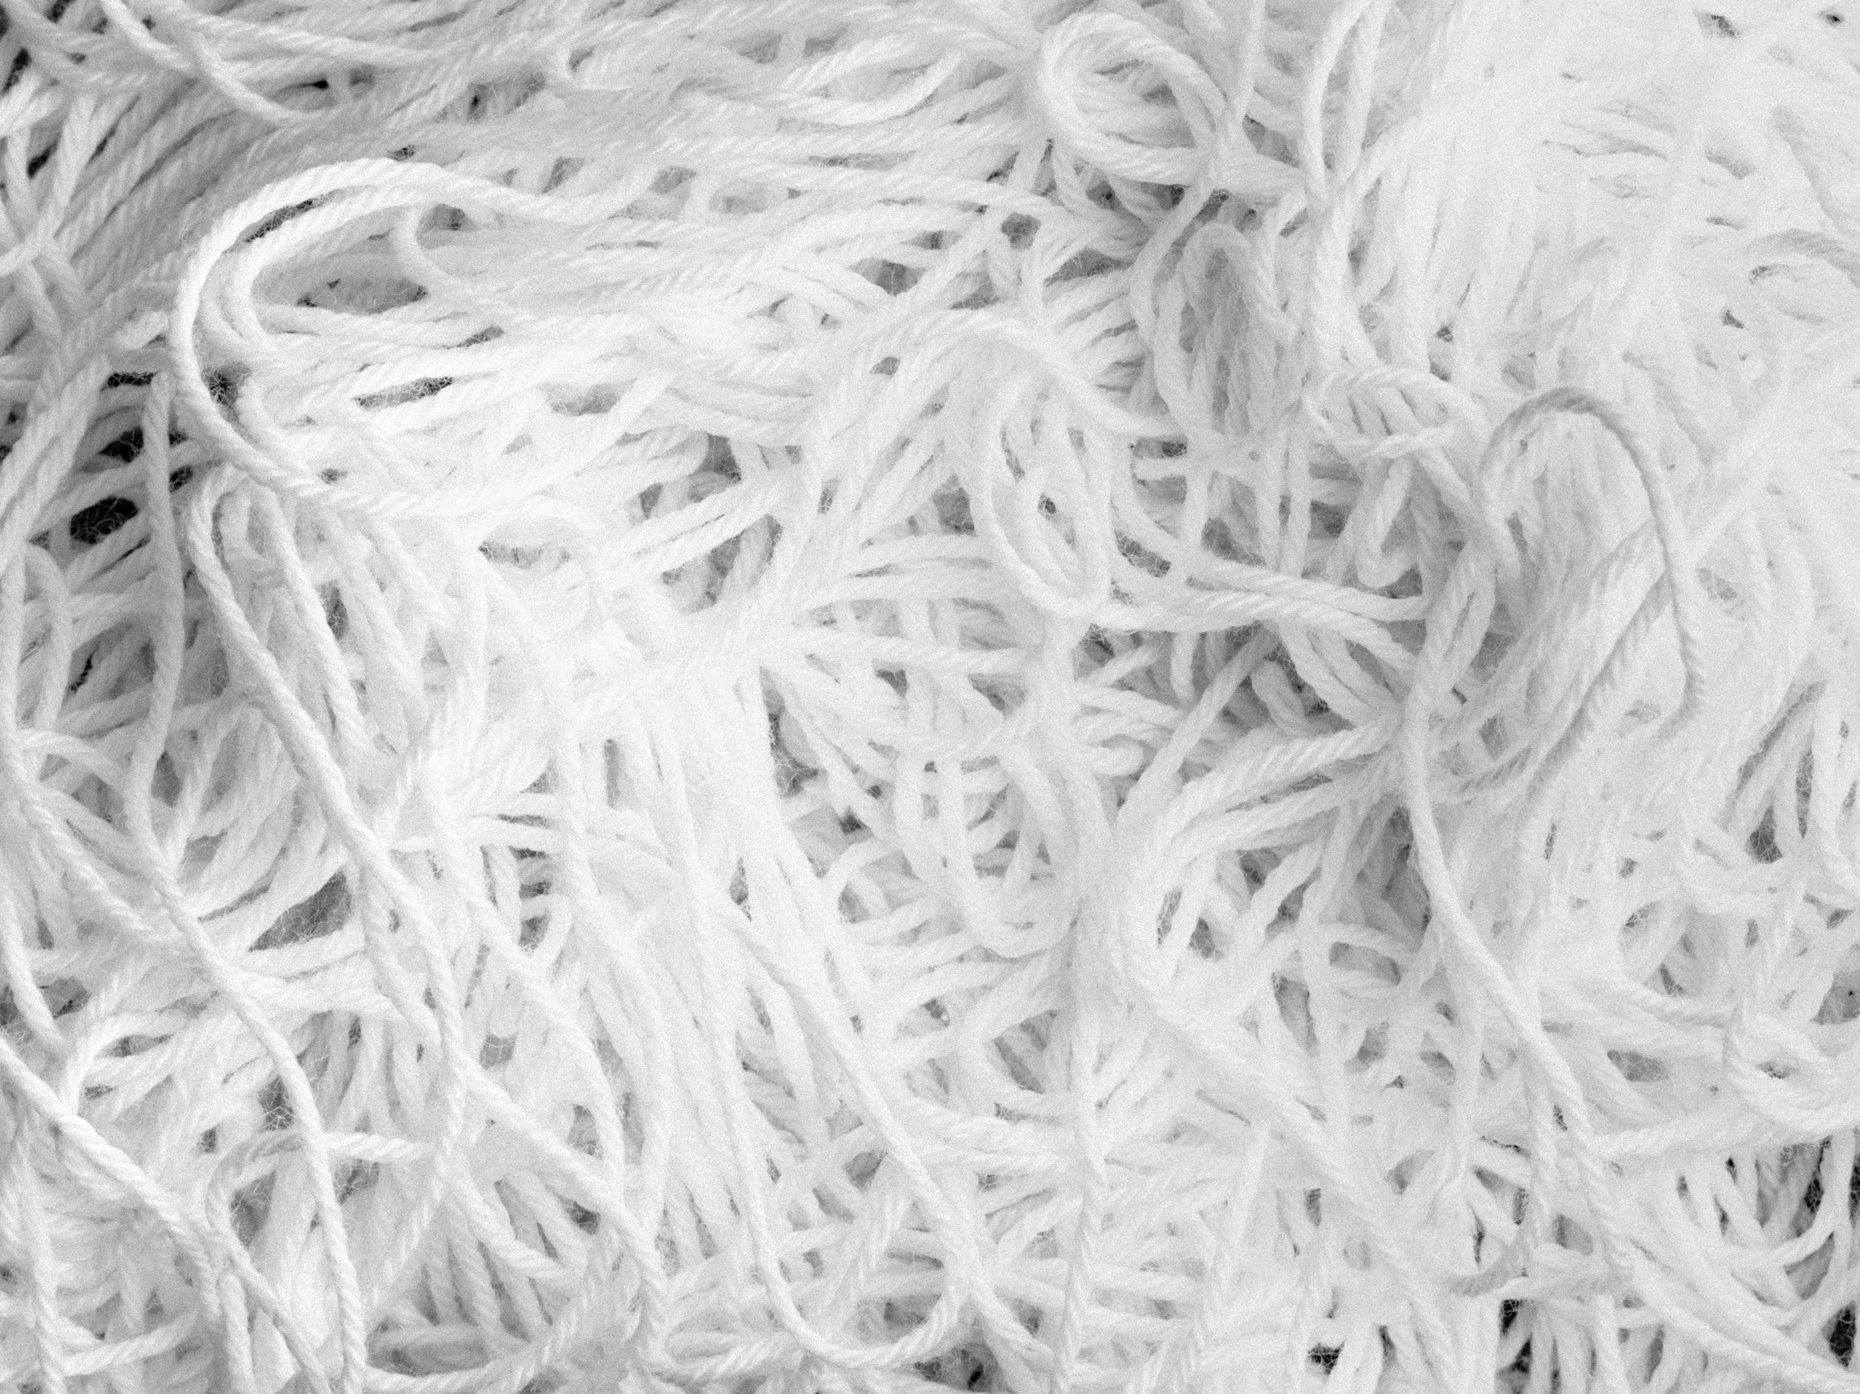
Single Instance of Everything
https://unsplash.com/photos/zyQ9_ylaAfg

Slide 21
Caching Instances
There are two hard problems:
1. Cache invalidation.
2. Naming things.
3. Off-by-one-errors.

Slide 22

No Clear Boundaries
https://unsplash.com/photos/wv81LrAGNz4

Slide 23
What’s the alternative?

Slide 24

Spring Data JDBC
https://unsplash.com/photos/x2Tmfd1-SgA

Slide 25
Entities are
Not proxied.
Not cached.
Loaded when asked for.
Saved when save is called.

Slide 26
Entities are
Grouped into Aggregates.

Slide 27
Give it a try
https://spring.io/projects/spring-data-jdbc
https://spring.io/blog/2018/09/24/spring-data-jdbc-references-and-aggregates

Slide 28
If you have to use JPA
Understand the 1st level cache.

Slide 29
Twitter: @jensschauder https://github.com/schauder/talk-jpa-complexity

